Slide 1

Welcome to Data Structures
LECTURE 1
Asst.Prof.Dr. Festim Halili
Department of Information Technology
International Balkan University

Slide 2

Contacts
Email: festim.halili@unite.edu.mk
http://sites.google.com/site/festimhalili3
www.ibu.edu.mk

Slide 3
Grading
Activity 20%
Midterm 40%
Final Exam 40%
Make up Exam covers the Final Exam points if student fails.
www.ibu.edu.mk

Slide 4



































IBSG – 25 billion devices connected to internet in 2015
Web Services
XML, SOAP, UDDI, HTTP
WSDL
Operating Systems
Programming Languages

Slide 5

Data Structures
  What this course is about:
  Data structures & algorithms
  Algorithm analysis
  Abstract Model of Data Structures ADT
  Additional of C++

Slide 6

What about data structures
Structure: how data is organized
  Place data contiguously
  Place data here and there with “links”
  Place data with “formula”

Slide 7

What about algorithms
Algorithms: how to access data for a result
  Scan data sequentially
  Scan data according to the sequence of a structure
  Scan data with “formula”
Algorithms: how to provide a smart solution

Slide 8

Basic data types – the simplest data structure
Basic data types a language supports:
  Integer, float, double, char, boolean
  string: usually an array of char supported with library

Slide 9
Basic Data structures
A single datum in one of the basic types
A structure is a combination of the basic types
  A Publication: code—string, description—string, price– double
A structure is a combination of basic types and structures
  An Order item: publication—Publication, quantity– integer, deleteFlag – boolean

Slide 10
Storage Container
For storing multiple occurrences of a structure
Contiguous structures:
  Array – supported by a language but needs care of array size, overflow
  Vector – a structure to allow handling of its size and overflow “automatically”
Linked List: allow data connected by “links” to save space which may be wasted in an array/vector.
Combination of vector and linked list

Slide 11
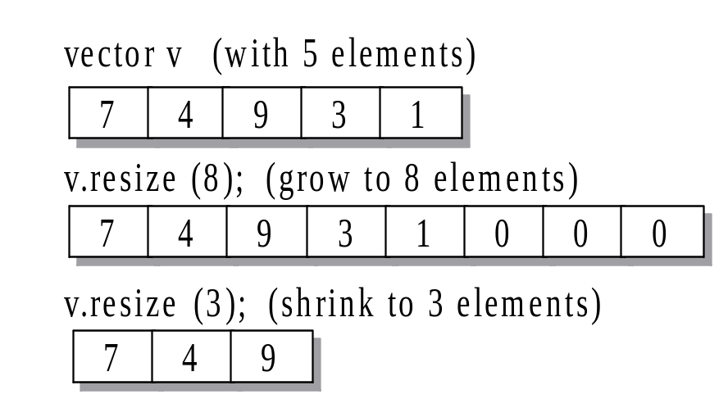
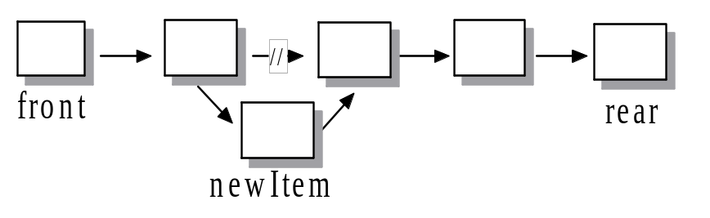
Examples of storage containers

Slide 12
Notes on the basic storage containers
Vector and list allow data to be stored in different ways but not restricted to any order, or any operations, e.g.,
Data can be ordered in any sequence, even though searching may prefer a sorted one.
Operations support inserting an element in between elements of a vector, even though it may involve a lot of “shift” operations.

Slide 13

ADT
An abstract model of a data structure together with the operations (can be treated as a form of algorithms) processed on the data structure.
In C++ or Java, an ADT can be implemented as a class.

Slide 14
Algorithms
A simplified view: clear process steps
E.g., A vector
reSize(int newSize) {
  Define a new array with newSize
  if newSize >= capacity
  Copy the contents from *array
  to the new array
  Assign newSize to capacity
  Make the new array as *array
  Throw away the old array
}
class Vector{
int *array;
int size;
int capacity;
……
};
  reSize() “automatically” re-defines an array according to the structure defined in Vector.
  There can be more: copy(), insert(), etc

Slide 15
Algorithms with “restrictive” containers
When data in containers are organized with some kind of restriction, algorithms may be improved in many cases
E.g., sequential search and binary search)
  Data can be stored in the basic storage containers in any order but they must be sorted before applying binary search

Slide 16
Data structures in this course
Many kinds of known containers allow “better” algorithms to be applied. In this course, we will look at some basic containers:
  Vector, List, Deque
  Map (Binary Search Tree)
  Hash map
  Stack and Queue

Slide 17
Algorithm not related to a restrictive structure
E.g., Linear search can find the maximum & minimum:
int min = max = at(0).getValue;
for (int i=1; i<siz(); i++) {
if ( at(i).getValue > max )
max = getValue;
if ( at(i).getValue < min )
min = getValu;
} // max and min is the result
Can it be faster without sorting the container?
How about comparing max with the greater one of each pair in the container.

Slide 18
Algorithm at “low level”
E.g., Use “cheaper” operations or better formula to achieve better execution time
int valueA / 2; can be rewritten as int valueA >> 1;
if ( value % 2 ) can be rewritten as if ( value & 1 )
➔We look for “smart” algorithms which may or may not relate to a data structure

Slide 19
Algorithm analysis
To understand how good or how bad an algorithm is
Theoretically evaluate an algorithm
  Execution time
  Storage efficiency
Experimentally evaluate an algorithm
  Use system clock to measure the execution time

Slide 20
Algorithms in this course
Other than basic algorithms related to the data structures in this course, in order to have better algorithms and algorithm analysis, some sorting methods will be studied, e.g., :
  Selection sort
  Insertion sort
  Merge sort
  Quick sort

Slide 21
Additional to C++
Extend the study of Data structures in:
  Using more STL’s classes
  Using pointers for “linked” structures
  Using reference for better implementation

Slide 22
A Brief Introduction to C++
We will provide a brief overview of C++
Many of the statements in C++ are very similar to C#
  It is assumed you remember these from Programming course

Slide 23
A Brief Introduction to C++
In this topic we will see:
  The similarities between C# and C++
  Some differences, including:
    Global variables and functions
    The preprocessor, compilation, namespaces
    Printing
  Concluding with
    Classes, templates
    Pointers
    Memory allocation and deallocation

Slide 24
Control Statements
All control statements are similar
if ( statement ) {
// ...
} else if ( statement ) {
// ... while ( statement ) {
} else { // ...
// ... }
}
for ( int i = 0; i < N; ++i ) {
// ...
do { }
// ...
} while ( statement );

Slide 25
Operators
Operators have similar functionality for built-in datatypes:
  Assignment =
  Arithmetic + - * / %
  += -= *= /= %=
  Autoincrement ++
  Autodecrement --
  Logical && || !
  Relational == != < <= >= >
  Comments /* */
  // to end of line
  Bitwise & | ^ ~
  &= |= ^=
  Bit shifting << >>
  <<= >>=

Slide 26
Arrays
Accessing arrays is similar:
    const int ARRAY_CAPACITY = 10; // prevents reassignment
    int array[ARRAY_CAPACITY];
    array[0] = 1;
    for ( int i = 1; i < ARRAY_CAPACITY; ++i ) {
    array[i] = 2*array[i – 1] + 1;
    }
Recall that arrays go from 0 to ARRAY_CAPACITY – 1
Definition:
The capacity of an array is the entries it can hold
The size of an array is the number of useful entries

Slide 27
Functions
Function calls are similar, however, the are not required to be part of a class:
    #include <iostream>
    using namespace std;
    // A function with a global name
    int sqr( int n ) {
    return n*n;
    }
    int main() {
    cout << "The square of 3 is " << sqr(3) << endl;
    return 0;
    }

Slide 28
C++/C# Differences
We will look at categories of differences between C++ and C#:
  Including header files (the preprocessor)
  The file is the base of compilation
  Namespaces
  Printing

Slide 29
The C++ Preprocessor
C++ is based on C, which was written in the early 1970s
Any command starting with a # in the first column is not a C/C++ statement, but rather a preprocessor statement
  The preprocessor performed very basic text-based (or lexical) substitutions
  The output is sent to the compiler

Slide 30
The C++ Preprocessor
The sequence is:
file (filename.cpp) → preprocessor → compiler (g++)
Note, this is done automatically by the compiler: no additional steps are necessary
At the top of any C++ program, you will see one or more directives starting with a #, e.g.,
  #include <iostream>

Slide 31
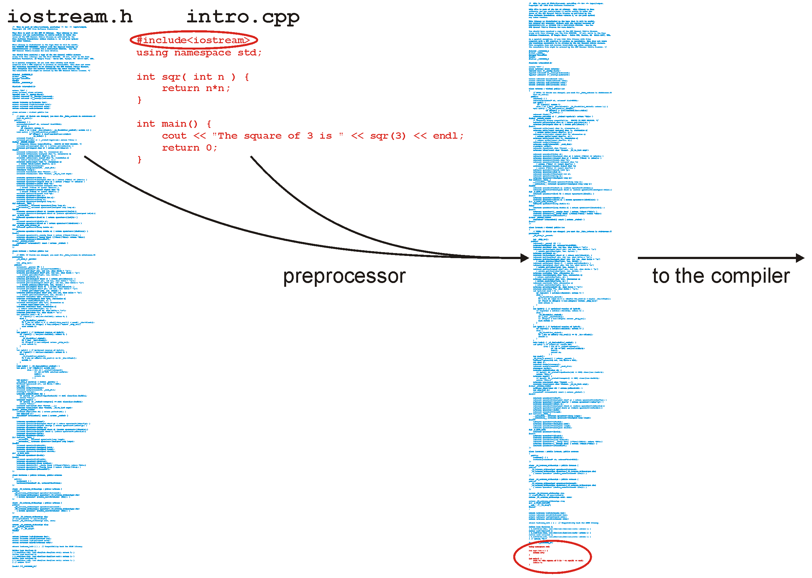
The C++ Preprocessor

Slide 32
Libraries
You will write your code in a file such as Single_list.h where you will implement a data structure
This file will be included in our tester file Single_list_tester.h with a statement such as:
#include "Single_list.h"
The file Single_list_int_driver.cpp then includes the tester file:
#include "Single_list_tester.h"

Slide 33
Libraries
You will note the difference:
#include <iostream>
#include "Single_list.h"
The first looks for a file iostream.h which is shipped with the compiler (the standard library)
The second looks in the current directory

Slide 34
Libraries
In this class, you will put all code in the header file
This is not normal practice:
  Usually the header (.h) file only contains declarations
  The definitions (the actual implementations) are stored in a related file and compiled into an object file

Slide 35
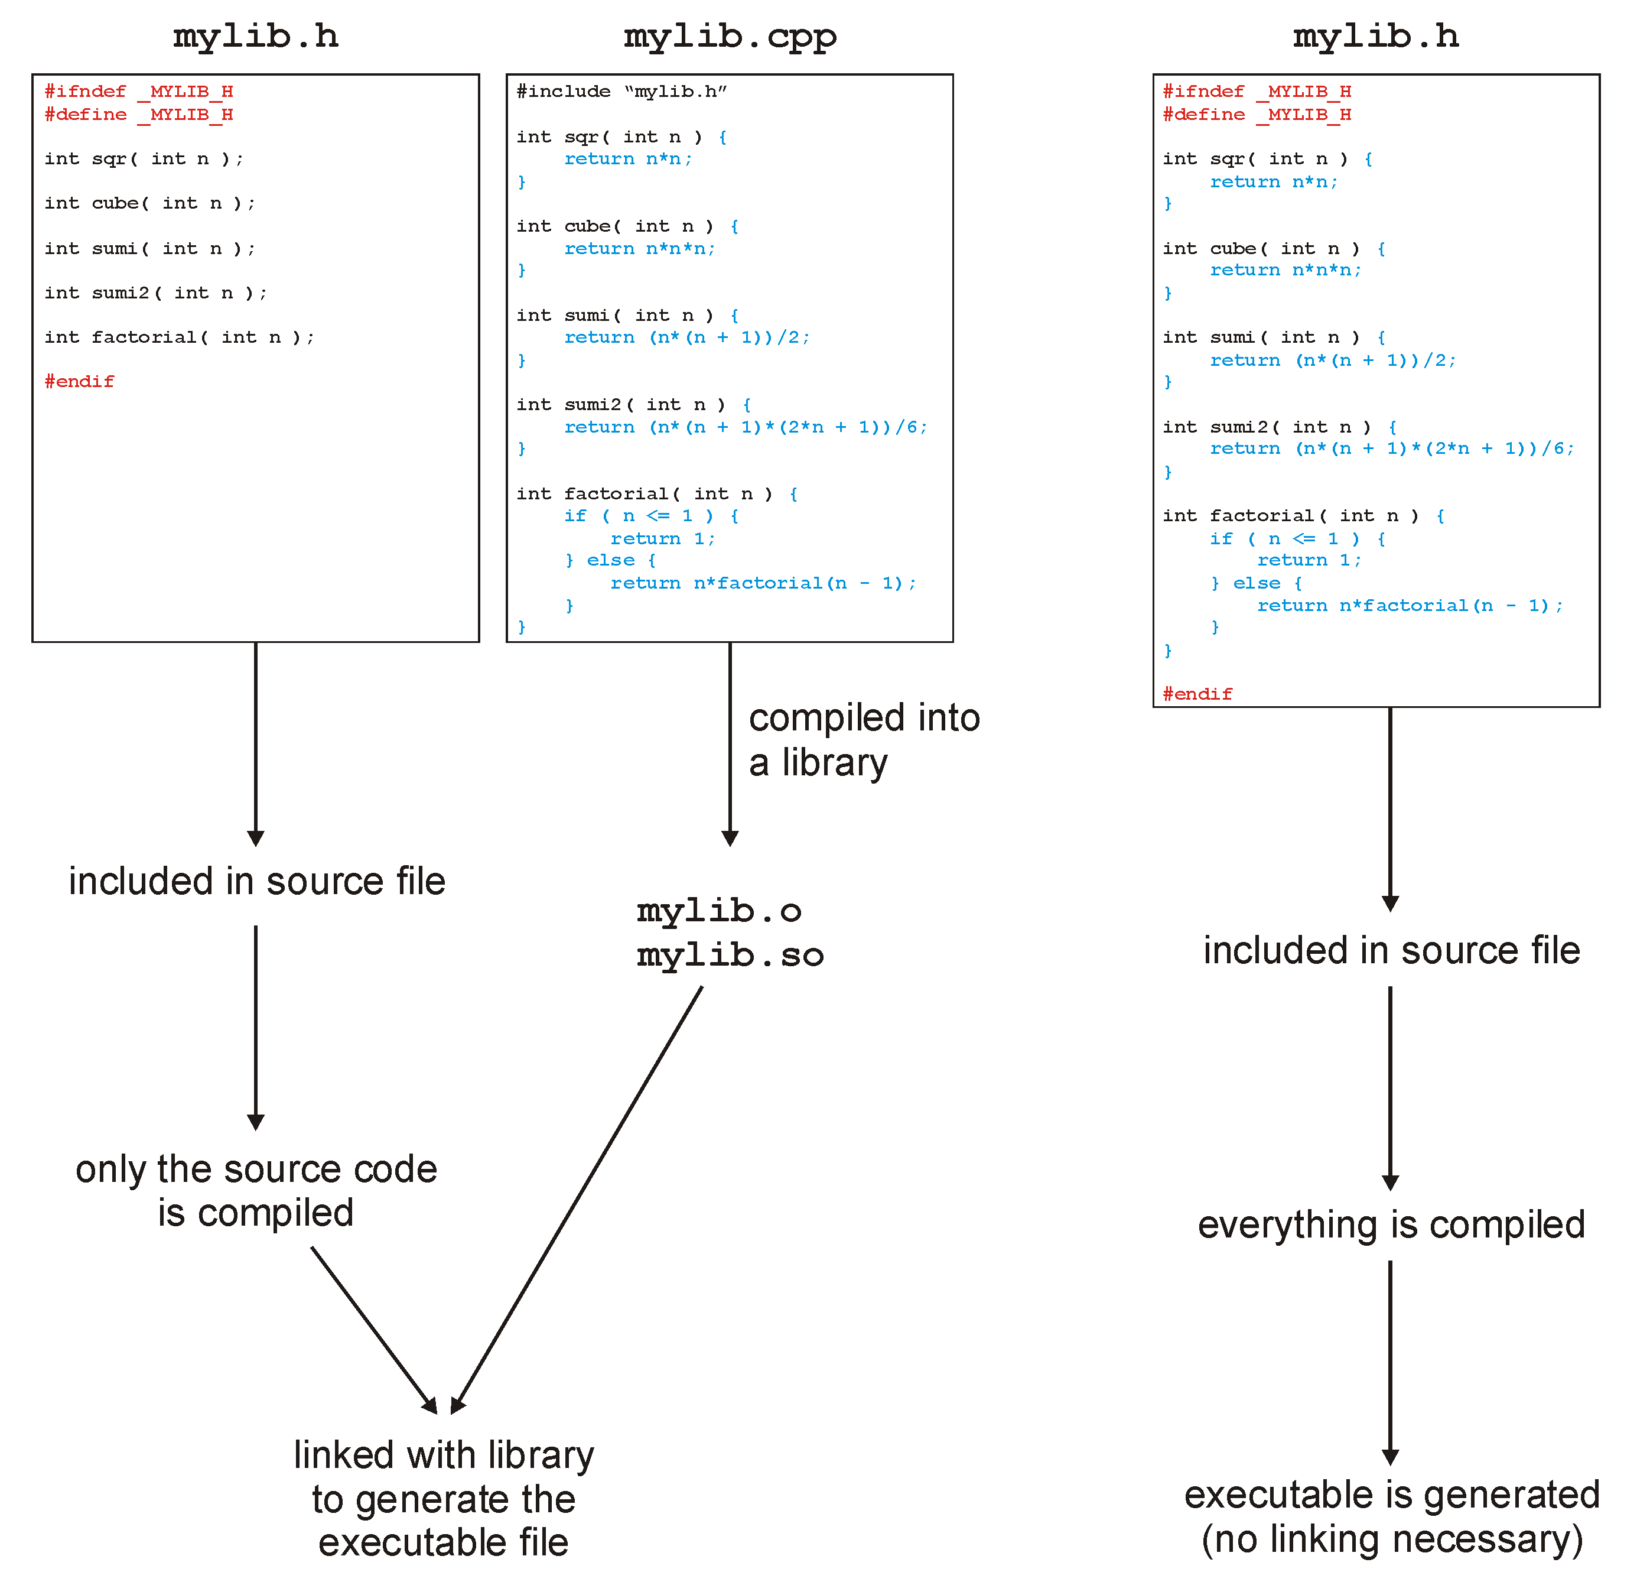
The C++ Preprocessor

Slide 36
The C++ Preprocessor
With all these includes, it is always necessary to avoid the same file being included twice, otherwise you have duplicate definitions
This is done with guard statements:
    #ifndef SINGLE_LIST_H
    #define SINGLE_LIST_H
    template <typename Type>
    class Single_list {
    ///...
    };
    #endif

Slide 37
The C++ Preprocessor
This class definition contains only the signatures (or prototypes) of the operations
The actual member function definitions may be defined elsewhere, either in:
  The same file, or
  Another file which is compiled into an object file
We will use the first method

Slide 38
The File as the Unit of Compilation
Another difference is the unit of compilation
In C#, the class was the basis of compiling executable code:
    class TestProgram {
    public static void Main() {
    System.Console.WriteLine( "Hello World" );
    }
    }
The existence of a function with the signature
public static void Main();
determines whether or not a class can be compiled into an executable

Slide 39
The File as the Unit of Compilation
In C/C++, the file is the base unit of compilation:
  Any .cpp file may be compiled into object code
  Only files containing an int main() function can be compiled into an executable
The signature of main is:
  int main () {
  // does some stuff
  return 0;
  }
The operating system is expecting a return value
  Usually 0

Slide 40
The File as the Unit of Compilation
This file (example.cpp) contains two functions
    #include<iostream>
    using namespace std;
    int sqr( int n ) { // Function declaration and definition
    return n*n;
    }
    int main() {
    cout << "The square of 3 is " << sqr(3) << endl;
    return 0;
    }

Slide 41
The File as the Unit of Compilation
To compile this file, we execute on the command line:
    {ecelinux:1} g++ example.cpp
    {ecelinux:2} ls
    a.out example.cpp
    {ecelinux:3} ./a.out
    The square of 3 is 9
    {ecelinux:4}

Slide 42
The File as the Unit of Compilation
This is an alternate form:
    #include<iostream>
    using namespace std;
    int sqr( int ); // Function declaration
    int main() {
    cout << "The square of 3 is " << sqr(3) << endl;
    return 0;
    }
    int sqr( int n ) { // Function definition
    return n*n; // The definition can be in another file
    }

Slide 43
Namespaces
Variables defined:
  In functions are local variables
  In classes are member variables
  Elsewhere are global variables
Functions defined:
  In classes are member functions
  Elsewhere are global functions
In all these cases, the keyword static can modify the scope

Slide 44
Namespaces
Global variables/variables cause problems, especially in large projects
  Hundreds of employees
  Dozens of projects
  Everyone wanting a function init()
In C++ (and XML), this is solved using namespaces

Slide 45
Namespaces
A namespace adds an extra disambiguation between similar names
    namespace ca_uwaterloo_dwharder {
    int n = 4;
    double mean = 2.34567;
    void init() {
    // Does something...
    }
    }
There are two means of accessing these global variables and functions outside of this namespace:
  The namespace as a prefix: ca_uwaterloo_dwharder::init()
  The using statement:
  using namespace ca_uwaterloo_dwharder;

Slide 46
Namespaces
You will only need this for the standard name space
  All variables and functions in the standard library are in the std namespace
#include <iostream>
std::cout << "Hello world!" << std::endl;
#include <iostream>
using namespace std; // never used in production code
cout << "Hello world!" << endl;

Slide 47
Printing
Printing in C++ is done through overloading the << operator:
cout << 3;
If the left-hand argument of << is an object of type ostream (output stream) and the right-hand argument is a double, int, string, etc., an appropriate function which prints the object is called

Slide 48
Printing
The format is suggestive of what is happening:
  The objects are being sent to the cout (console output) object to be printed
cout << "The square of 3 is " << sqr(3) << endl;
The objects being printed are:
  a string
  an int
  a platform-independent end-of-line identifier

Slide 49
Printing
How does
cout << "The square of 3 is " << sqr(3) << endl;
work?
This is equivalent to
((cout << "The square of 3 is ") << sqr(3)) << endl;
where << is an operation (like +) which prints the object and returns the cout object

Slide 50
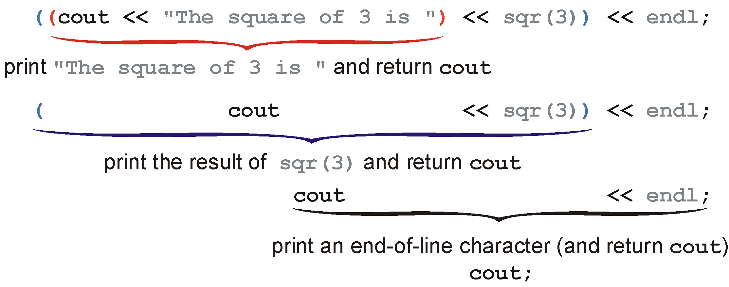
Printing
Visually:

Slide 51
Printing
Another way to look at this is that
cout << "The square of 3 is " << sqr(3) << endl;
is the same as:
operator<<( operator<<( operator<<( cout, "The square of 3 is " ), sqr(3) ), endl );
This is how C++ treats these anyway...

Slide 52
Introduction to C++
The next five topics in C++ will be:
  Classes
  Templates
  Pointers
  Memory allocation
  Operator overloading
With these, you will have (more than) enough information to start Project 1
  Project 1 is simply the implementation of a few variations of linked lists

Slide 53
Classes
To begin, we will create a complex number class
To describe this class, we could use the following words:
  Store the real and imaginary components
  Allow the user to:
    Create a complex number
    Retrieve the real and imaginary parts
    Find the absolute value and the exponential value
    Normalize a non-zero complex number

Slide 54
UML Class Diagrams
Instead, another way to summarize the properties of a class is through UML Class Diagrams
UML, the Unified Modeling Language is a collection of best practices used in designing/modeling (among other things) software systems

Slide 55
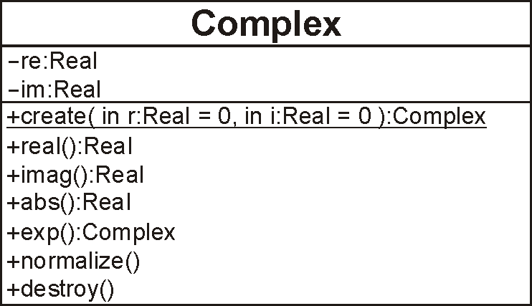
UML Class Diagrams
The Class Diagram for what we describe may be shown as the following box:

Slide 56
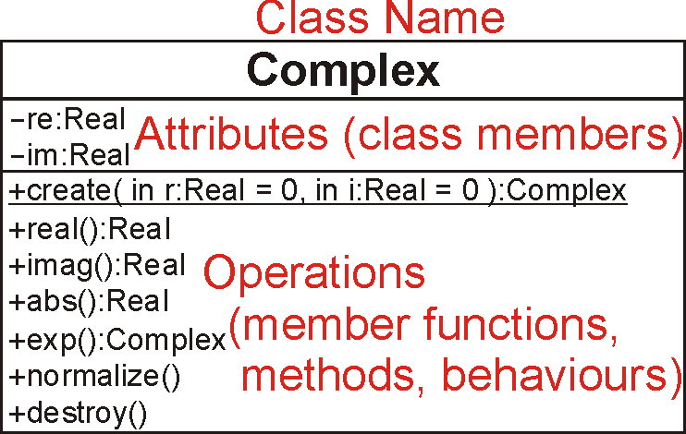
UML Class Diagrams
The three components include:
  the name, the attributes, and the operations

Slide 57
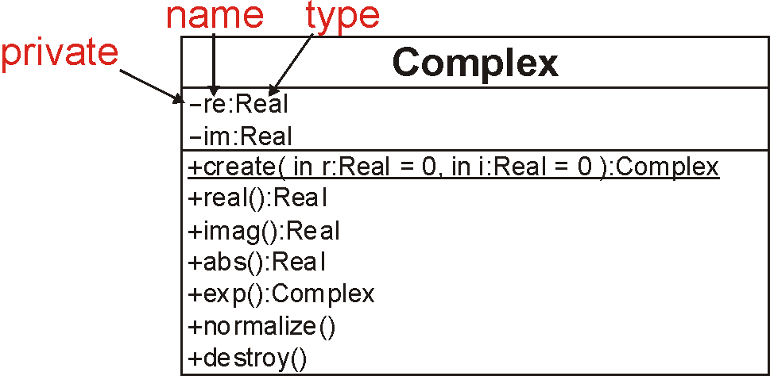
UML Class Diagrams
The attributes are described by:
  a visibility modifier, a name, and a type

Slide 58
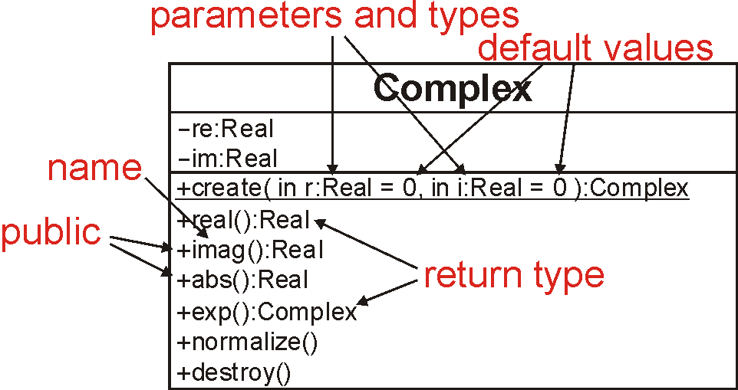
UML Class Diagrams
The operations (a.k.a. functions) include:
  a visibility modifier, a name, parameters (possibly with default values) and return values

Slide 59
Classes
An example of a C++ class declaration is:
class Complex {
private:
double re, im;
public:
Complex( double = 0.0, double = 0.0 );
double real() const;
double imag() const;
double abs() const;
Complex exp() const;
void normalize();
};

Slide 60
Classes
This only declares the class structure
  It does not provide an implementation
We could, like C#, include the implementation in the class declaration, however, this is not, for numerous reasons, standard practice

Slide 61
The Complex Class
The next slide gives both the declaration of the Complex class as well as the associated definitions
  The assumption is that this is within a single file

Slide 62
The Complex Class
#ifndef _COMPLEX_H
#define _COMPLEX_H
#include <cmath>
class Complex {
private:
double re, im;
public:
Complex( double = 0.0, double = 0.0 );
// Accessors
double real() const;
double imag() const;
double abs() const;
Complex exp() const;
// Mutators
void normalize();
};

Slide 63
The Complex Class
// Constructor
Complex::Complex( double r, double i ):
re( r ),
im( i ) {
// empty constructor
}
Associates functions back to the class
Each member variable should be assigned
The order must be the same as the order in which
the member variables are defined in the class
For built-in datatypes, this is a simple assignment.
For member variables that are objects, this is a call
to a constructor.
For built-in datatypes, the above is equivalent to:
// Constructor
Complex::Complex( double r, double i ):re( 0 ), im( 0 ) {
re = r;
im = i;
}

Slide 64
The Complex Class
// return the real component
double Complex::real() const {
return re;
}
// return the imaginary component
double Complex::imag() const {
return im;
}
// return the absolute value
double Complex::abs() const {
return std::sqrt( re*re + im*im );
}
Refers to the member variables re and im of this class

Slide 65
The Complex Class
// Return the exponential of the complex value
Complex Complex::exp() const {
double exp_re = std::exp( re );
return Complex( exp_re*std::cos(im), exp_re*std::sin(im) );
}

Slide 66
The Complex Class
// Normalize the complex number (giving it unit absolute value, |z| = 1)
void Complex::normalize() {
if ( re == 0 && im == 0 ) {
return;
}
double absval = abs();
re /= absval;
im /= absval;
}
#endif
This calls the member function double abs() const
from the Complex class on the object on which
void normalize() was called

Slide 67
Visibility
Visibility in C# and Java is described by placing public/private/protected in front of each class member or member function
In C++, this is described by a block prefixed by one of
  private:
  protected:
  public:

Slide 68
Visibility
class Complex {
private:
double re, im;
public:
Complex( double, double );
double real() const;
double imag() const;
double abs() const;
Complex exp() const;
void normalize();
};

Slide 69
Visibility
The reason for the change in Java/C# was that the C++ version has been noted to be a source of errors
Code could be cut-and-paste from one location to another, and a poorly placed paste could change the visibility of some code:
  public → private automatically caught
  private → public difficult to catch and dangerous

Slide 70
Visibility
It is possible for a class to indicate that another class is allowed to access its private members
If class ClassX declares class ClassY to be a friend, then class ClassY can access (and modify) the private members of ClassX

Slide 71
Visibility
class ClassY; // declare that ClassY is a class
class ClassX {
private:
int privy; // the variable privy is private
friend class ClassY; // ClassY is a "friend" of ClassX
};
class ClassY { // define ClassY
private:
ClassX value; // Y stores one instance of X
public:
void set_x() {
value.privy = 42; // a member function of ClassY can
} // access and modify the private
}; // member privy of "value"

Slide 72
Summary
This course studies data structures and algorithms with C++ implementation
Organization of a data structure may allow better algorithms to be applied
Algorithms can be smarter without a special organization of a data structure
There are ways to measure or evaluate an algorithm

Slide 73

Questions

